Slide 1







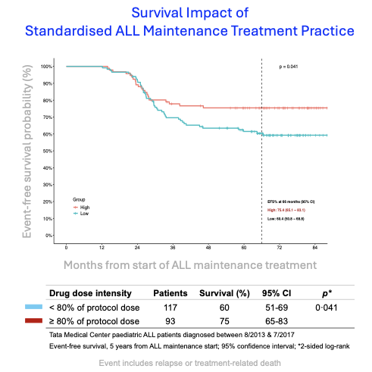





Acute Lymphoblastic Leukemia (ALL) Treatment
Intensive Phase
Maintenance Therapy (MT)
Bi-weekly absolute neutrophil count and platelets check based
on which oral chemotherapy drugs are prescribed
6 months
2 years
Electronic Health
Records
Continue data collection
TOOLS for physicians to evaluate MT in real-time
2019-2023
Evidence for suboptimal MT
MT Data Repository for Research Studies
Pilot Study
2014-2016
allMT R Library for analyzing MT data
Available on CRAN
VIATAMIN R application
Hosted publicly
Strict adherence to treatment protocol
1st of its own kind publicly available of ALL patients treated between 2013-2022
2016-2019
2024
2020
Pill Reminder mobile application
Automated Dose Advice Method (ADAM) Clinical Decision Support System
PROTOTYPE tools for treatment protocol adherence
E-mail blood report
Drug prescription
Drug prescription
E-mail blood report
Currently in 2024, ADAM is undergoing real-time clinical validation
In-person clinic was converted to hybrid mode clinic (In-person and E-mail clinic)
Patient Family

